Slide 1

SAIL.R – Journey Towards R Software for Statisticians in Johnson & Johnson One-day PSI/PHUSE Event: Change Management for Moving to R/Open-Source Cambridge, UK 3rd July 2025
Yannick Vandendijck
Senior Principal Scientist Biostatistics Johnson & Johnson Innovative Medicine, Belgium
The views and opinions expressed in this presentations are those of the speakers and do not necessarily reflect the views or positions of any entities they represent

Slide 2

Introduction of the R Journey

Slide 3
2019 - 2020 | 2021 | 2022 | 2023 | 2024 | 2025
6
Detailing the road map from Idea to Implementation
5
4
Existing OS interactive framework extended for J&J (teal)
Adoption of static R as business as usual
More advanced R training for stats
3
2
Contribute to R OS frameworks, and creation of new TLG Standards in R using OS framework
First hybrid submissions
Introduction to R training for stats
1
Developed infrastructure for interactive R in SPACE
Shift strategy to use existing R OS frameworks (rtables & tern)
More and more R Shiny apps and R markdown reports developed
Open-sourced first R packages (tidytlg)
Standard R TLG Code Catalog
Internal initiative of comparing SAS and R efficacy analysis (cfr. PHUSE CAMIS)
R becomes a Flagship Initiative
Developed infrastructure and process for R in SPACE
Machine learning training series using R
Explore the use of R for static and interactive
Multiple trainings on ggplot in R.
OS = open-source
Notes:
Mainly driven by our Statistical Programming group

Slide 4

Why in a Statistician’s Toolbox?
Open-source software offers many opportunities
Impressive visualization and interactive opportunities
Faster development of packages and functions of new statistical methodologies
Wide range of packages/libraries
Large online community (increases problem-solving speeds, genAI)
Hiring opportunities: R is used in universities
Seamless integration with other data analysis software (e.g., other Bayesian software)
Partner with other pharma companies, collaborate in the open-source mindset

Slide 5




Change managment
Drive the adoption and implementation of R for clinical statisticians
Regulatory acceptance of R
R Training
Comparing R vs SAS results
Open-source mindset
Notes:
Some I’ll go in detail, some not

Slide 6
Change managment
Drive the adoption and implementation of R for clinical statisticians
Regulatory acceptance of R
R Training
Comparing R vs SAS results
Open-source mindset
Notes:
Some I’ll go in detail, some not

Slide 7
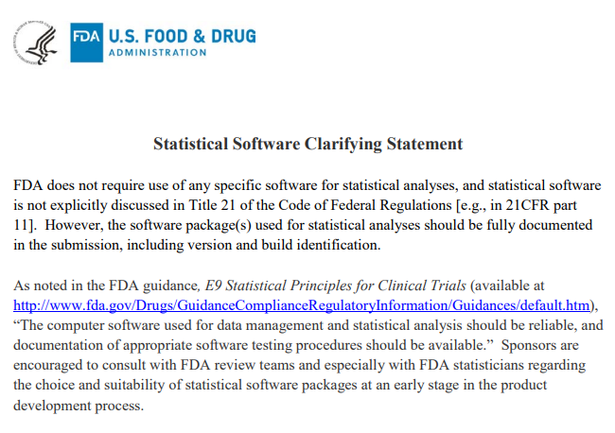
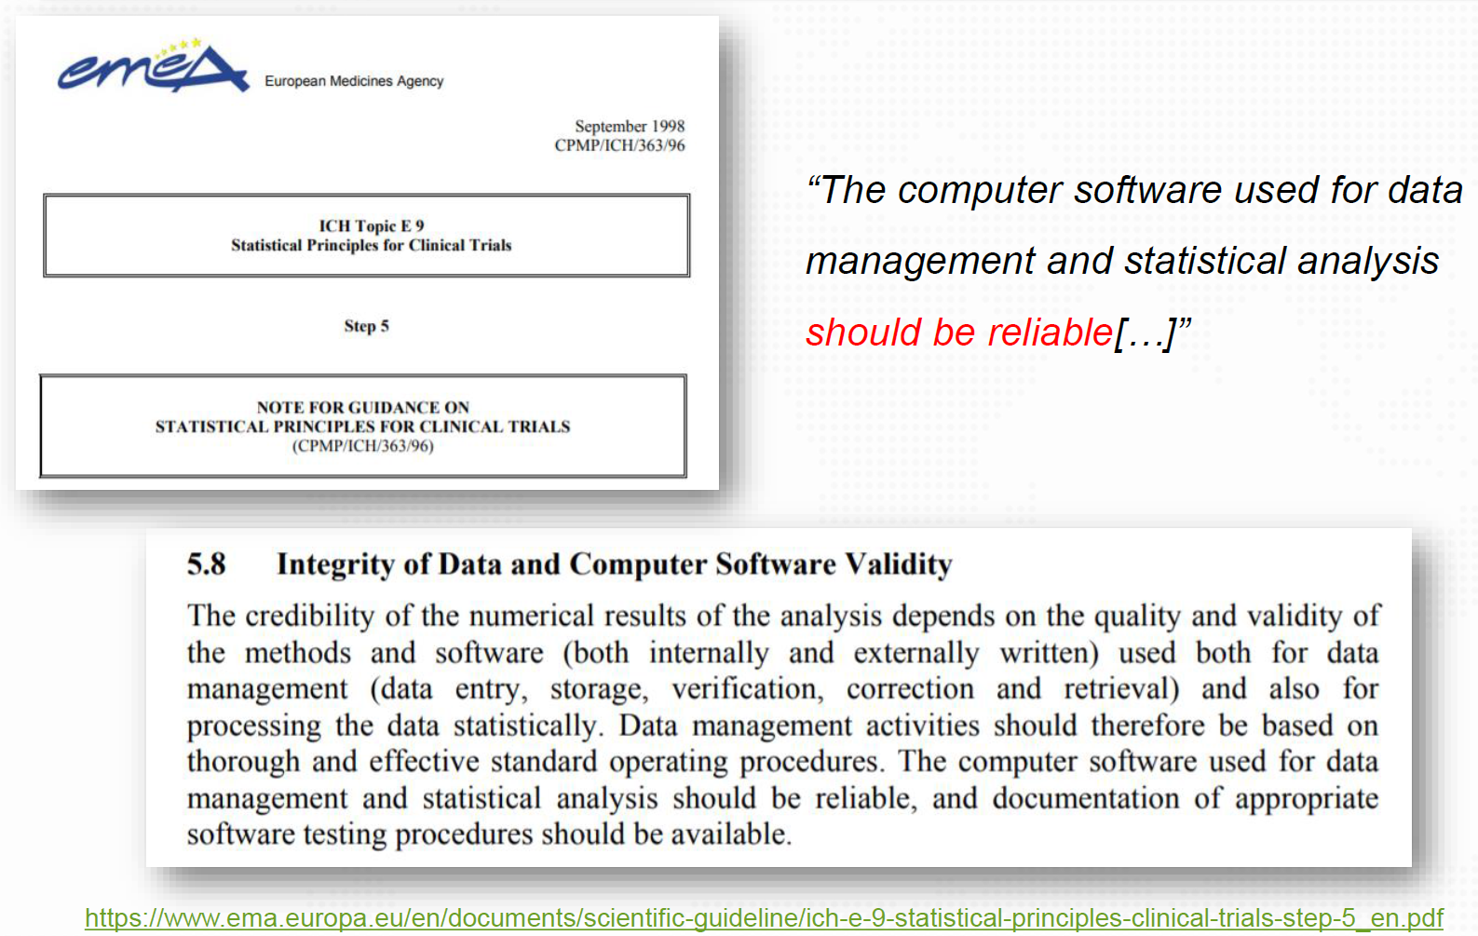
Regulatory Acceptance is Key
FDA, EMEA, Japan PMDA: there is no requirement for a specific statistical software
China NMPA: can accept R code but expects corresponding SAS code as well. A cross-pharma workgroup has been set up to prepare NMPA for R based submissions.

Slide 8
Change managment
Drive the adoption and implementation of R for clinical statisticians
Regulatory acceptance of R
R Training
Comparing R vs SAS results
Open-source mindset
Training on the effective use of R for exploring, summarizing and visualizing clinical data
Notes:
Some I’ll go in detail, some not

Slide 9
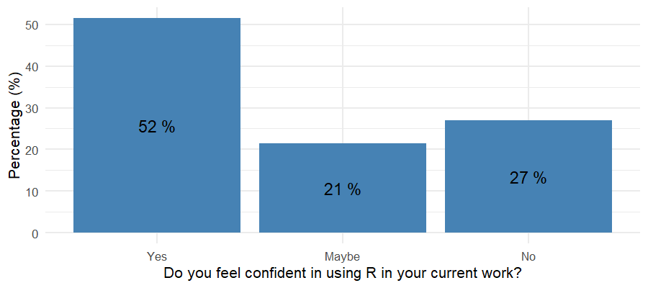
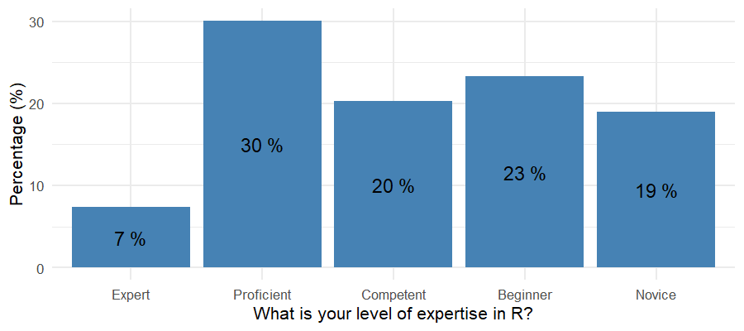
Make sure you know the Audience
What skills do they need to be trained on?
What skills do they already have?
What are the competing priorities for the audience?
…
Increasing interest in using R in recent years
Target: statisticians working with clinical data
Large cohort needed training (± 220)
Very heterogeneous R proficiency
Difficult to set aside time for training

Slide 10
Make sure you know the Audience
What skills do they need to be trained on?
What skills do they already have?
What are the competing priorities for the audience?
…
Increasing interest in using R in recent years
Target: statisticians working with clinical data
Large cohort needed training (± 220)
Very heterogeneous R proficiency
Difficult to set aside time for training
Became our trainers - more junior colleagues
Develop training materials and provide the trainings
Across therapeutic areas and groups (ED – LD) to develop network of R experts

Slide 11



Curriculum
QC using R
Great start for R adaption
Building blocks for QC
Training on more automation & interactive exploration
Innovative R tools useful for clinical statisticians
Requires basic R knowledge
Advancing proficiency in R
How to write R functions
Loops, apply, simulation
rtables, tern and teal packages

Slide 12
Curriculum
Building blocks for QC in R
Very important for the R-savvy statisticians in our organization as well
Lesson 1: R and RStudio in SPACE | Lesson 2: R Programming Basics | Lesson 3: Data Manipulations [1]
Setup R environment in SPACE RStudio interface Navigate RStudio | Intro to R objects (vectors, factors, matrices, data frames, etc.) Descriptive statistics R packages Loading data | dplyr package (filter, select, rename, summarize, group by, …) Joining data
Lesson 4: Data Manipulations [2] | Lesson 5: Data Visualization [1] | Lesson 6: Data Visualization [2]
Pivoting data Dates and times Compare datasets tidytlg package | Introduction to ggplot Important geom functions Building a good-looking figure Customize figures | More examples of ggplot: bar graphs, box plots, line plots, forest plots tidytlg package
Lesson 7: Modelling 1 | Lesson 8: Modelling 2
Binary endpoints Continuous endpoints | mmrm package Survival analysis

Slide 13
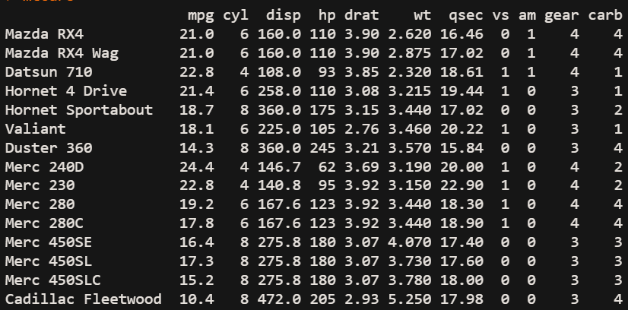
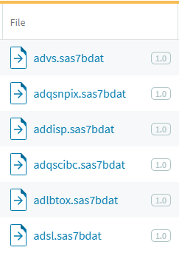
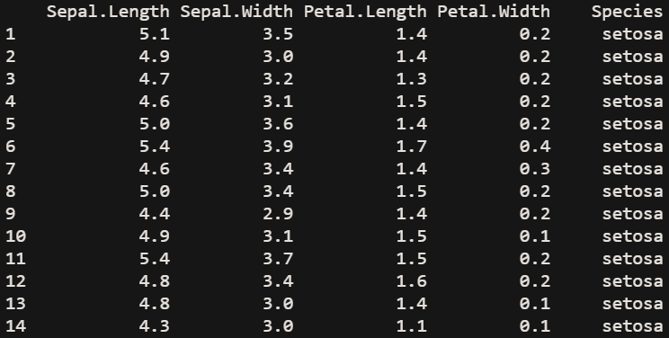
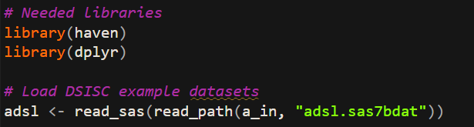
Making the training relevant !!!

Slide 14
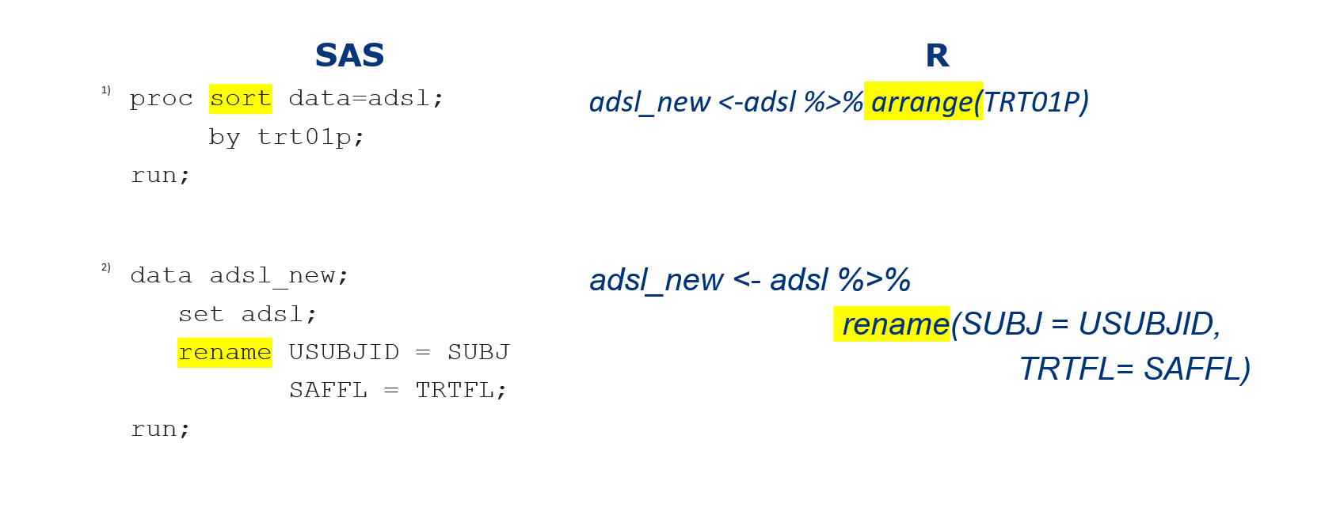
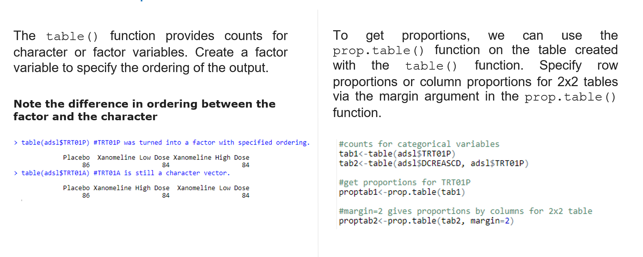
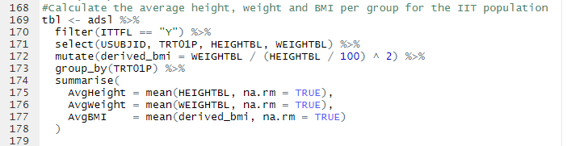
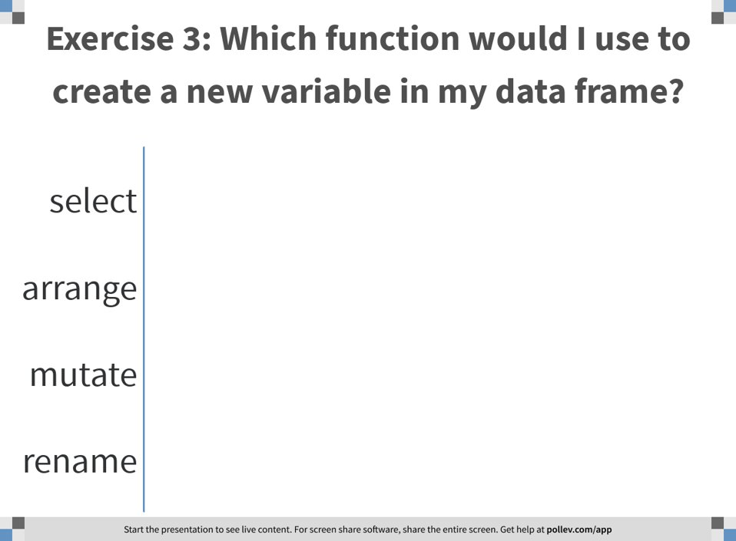
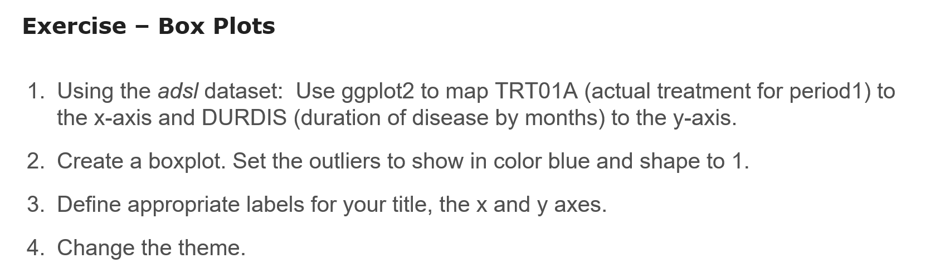
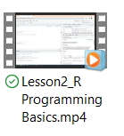
Implementation
R vs SAS
3
Each training followed a consistent and standardized structure
Consistent version of R, R-Studio, set of packages
All examples on SDTM and ADaM data (clinical test data from CDISC)
Slides
Demo code
1
2
Class Polls
4
Exercises
5
Videos
6

Slide 15
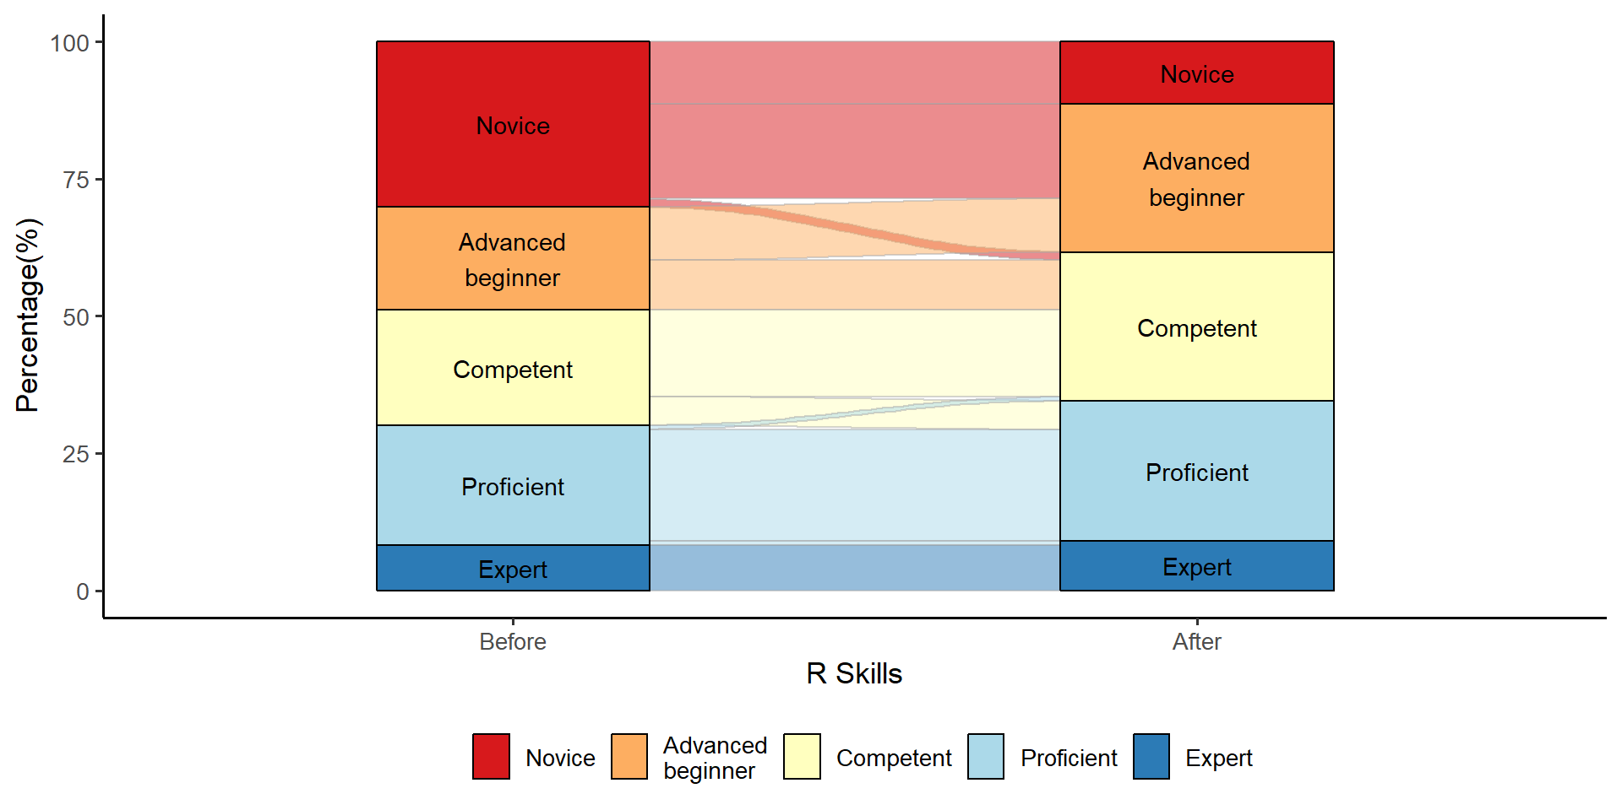
Evaluation
40+ classes (approx 180 individuals trained, across US, EU, AP)
Training was relevant to their daily work
We should have put more focus on making errors!

Slide 16
Change managment
Drive the adoption and implementation of R for clinical statisticians
Regulatory acceptance of R
R Training
Comparing R vs SAS results
Open-source mindset
Notes:
Some I’ll go in detail, some not

Slide 17

Me on July 7, 2023 at 14h27
Images created using OpenAI DALL-E 3

Slide 18
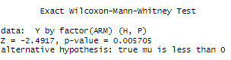
QC results (in R) gave a different p-value as SAS
 | Placebo | Low Dose | High Dose
Analysis set: Per Protocol | 10 | 10 | 10
Exact Wilcoxon Rank Sum Test
N | 10 | 10 | 10
p-value² |  | 0.2339 | 0.0057
² One-sided p-value
Hypothesis is that the response Y on high dose is reduced compared to placebo (similar for low dose).
Note: The coin::wilcox_test() function in R was used for QC

Slide 19
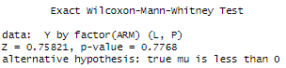
QC results (in R) gave a different p-value as SAS
 | Placebo | Low Dose | High Dose
Analysis set: Per Protocol | 10 | 10 | 10
Exact Wilcoxon Rank Sum Test
N | 10 | 10 | 10
p-value² |  | 0.2339 | 0.0057
² One-sided p-value
Hypothesis is that the response Y on high dose is reduced compared to placebo (similar for low dose).
Note: The coin::wilcox_test() function in R was used for QC

Slide 20


It would be great if there would be a resource that aims to describe how analysis results in different software can be matched perfectly or knowing the source of any discrepancies

Slide 21
CAMIS Objectives
Differences with SAS can cause uncertainty, apprehension and nervousness about the use of open-source software
Increase understanding and awareness of analysis result differences across software (R, SAS®, Python etc)
Understanding how to mimic analysis results across software is critical
To demonstrate the methodology through examples, document in open GitHub repository
CAMIS contributes to the confidence in reliability of open-source software by understanding how analysis results can be matched perfectly or knowing the source of any discrepancies

Slide 22
Change managment
Drive the adoption and implementation of R for clinical statisticians
Regulatory acceptance of R
R Training
Comparing R vs SAS results
Open-source mindset
Notes:
Some I’ll go in detail, some not

Slide 23
The message we want to convey
If you find an issue/error, don’t think or shout “R sucks!”
But apply the open-source mindset
Do reach out to package developers if you find an issue
Most package have the possibility to report issues through Github (if not each package has an email from the contributor)
If you are common to Github, you can update the code yourself and ask to developer to check it and do PR

Slide 24
Discussion

Slide 25
Discussion
Change to R is also about people
Take-away hesitation and nervousness around open-source software
Get to know the R level in your organization?
Make training relevant, relevant and relevant!
Management support is very important
Open-source software comes with an open-source mindset

Slide 26
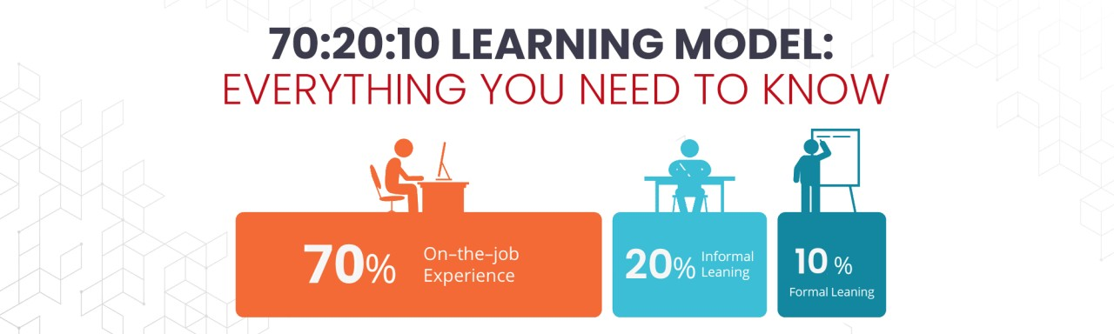
70-20-10 Learning model
Figure from https://www.linkedin.com/pulse/702030-learning-model-everything-you-need-know-timelabspro

Slide 27
Questions Comments Suggestions
A big thanks to all colleagues involved in SAIL.R

Slide 28
References
1. https://www.r-project.org/ (2024)
2. https://pharmaverse.org/ (2024)
3. Statistical Software Clarifying Statement. FDA (2015). Available at https://fda.report/media/109552/Statistical-Software-Clarifying-Statement-PDF.pdf
4. ICH harmonised tripartite guideline: statistical principles for clinical trials (E9) (1988). Available at http://www.fda.gov/Drugs/GuidanceCompliance RegulatoryInformation/Guidances/default.htm
5. Wickham H, François R, Henry L, Müller K (2022). dplyr: A Grammar of Data Manipulation. https://dplyr.tidyverse.org, https://github.com/tidyverse/dplyr.
6. Masel N, Haesendonckx S, Alexandra Papadopoulou P, Wang S, Miller E, Kosiba N, Ceney A (2023). tidytlg: Create TLGs using the 'tidyverse'. https://pharmaverse.github.io/tidytlg/main/
7. Wickham H (2016). ggplot2: Elegant Graphics for Data Analysis. Springer-Verlag, New York.
8. Sabanes Bove D, Dedic J, Kelkhoff D, Kunzmann K, Lang B, Li L, Stock C, Wang Y, James D, Sidi J, Leibovitz D, Sjoberg D (2023). mmrm: Mixed Models for Repeated Measures. https://openpharma.github.io/mmrm/.
9. https://rmarkdown.rstudio.com/ (2024)
10. Sievert C (2020). Interactive Web-Based Data Visualization with R, plotly, and shiny. Chapman and Hall/CRC, Florida.

Slide 29
Back-up

Slide 30
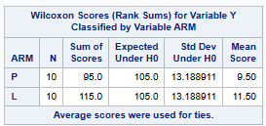
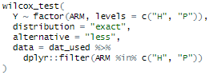
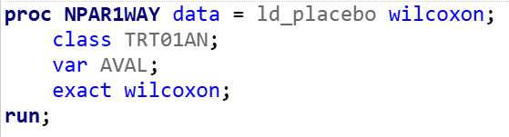
R vs SAS: different results for one-sided p-value if the direction is opposite to the expectation
Placebo
Low dose
In SAS, you can’t specify the direction of the one-sided p-value
…For one-sided tests, PROC NPAR1WAY displays the right-sided p-value when the observed value of the test statistic is greater than its expected value. The right-sided p-value is the sum of probabilities for those tables with a test statistic that is greater than or equal to the observed test statistic…
In R, you can specify the direction of the one-sided p-value
[coin::wilcox_test() function]

Slide 31



Why do we need CAMIS?
But what happens if we do statistical analysis in open-source software?
Do we get the same results as we got in SAS®?
Mostly the same
…but not always
This causes uncertainty, apprehension and nervousness about the use of R
But which software is “correct”?
Why do they differ?
Finding out is very time consuming !!!!

Slide 32
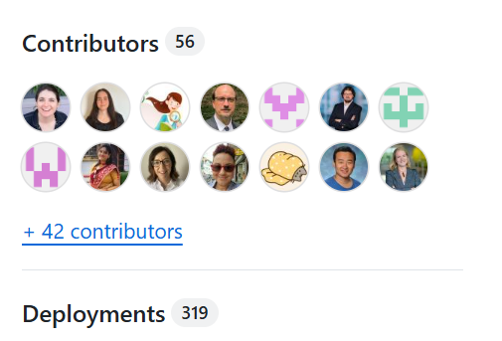

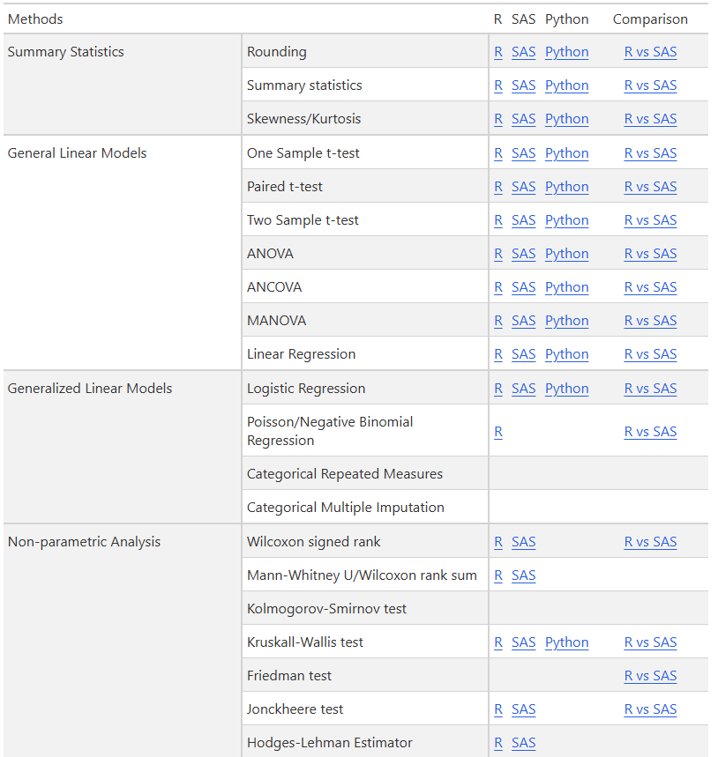
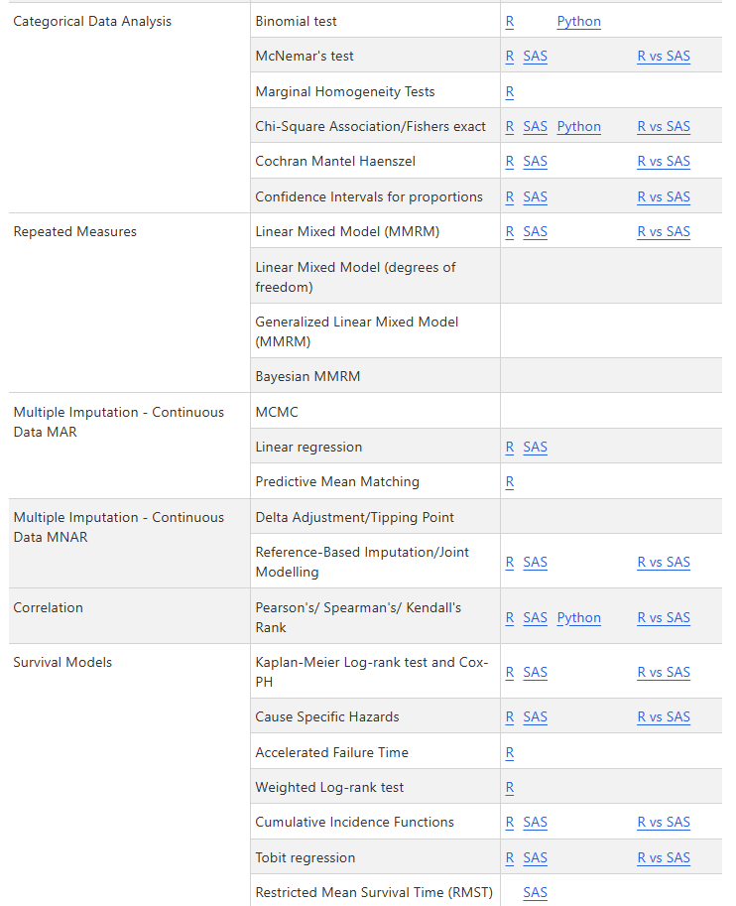
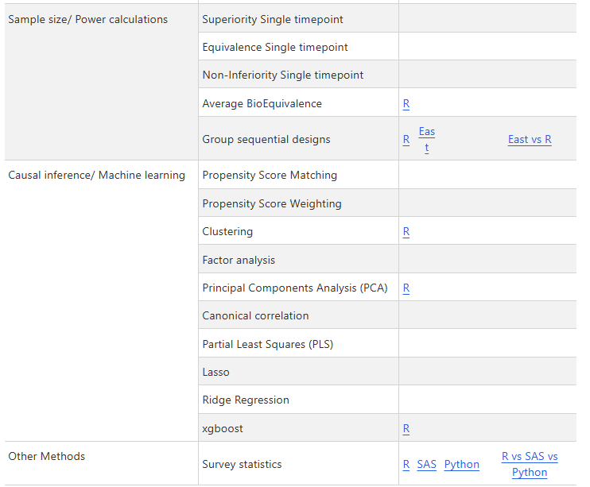
CAMIS today
https://github.com/PSIAIMS/CAMIS

